Slide 1
20XD24 - OBJECT ORIENTED PROGRAMMING
Chapter – VIII
File Handling

Slide 2
Outline
String I/O
Character I/O
Object I/O
I/O with multiple Objects
File pointers
Disk I/O with member functions

Slide 3
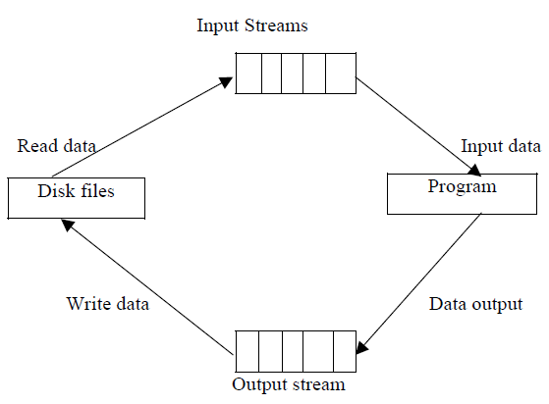
Stream Classes
A stream is a general name given to a flow of data. In C++, a stream is represented by an object of a particular class
So far we’ve used the cin and cout stream objects. Different streams are used to represent different kinds of data flow
For example, the ifstream class represents data flow from input disk files
Figure : File Input and output stream

Slide 4
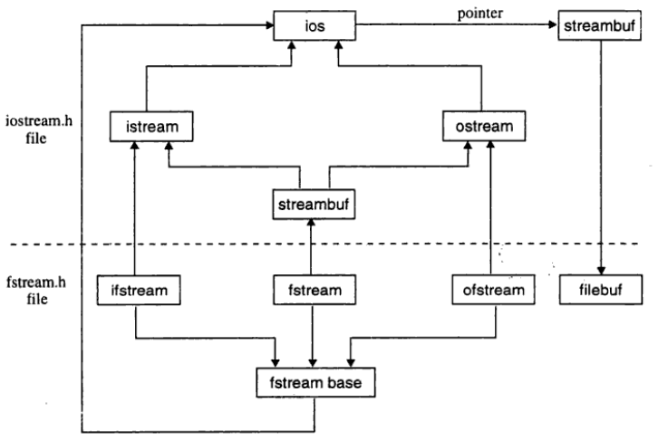
The Stream Class Hierarchy

Slide 5
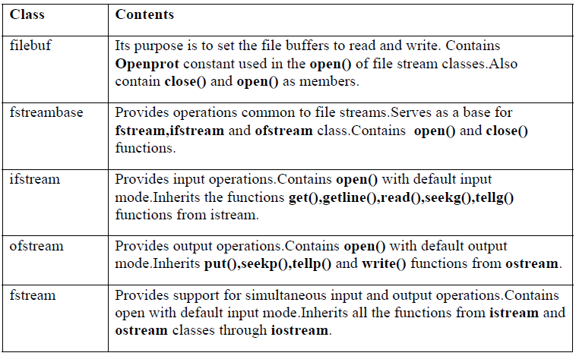
The Stream Class Hierarchy
The classes used specifically for disk file I/O are declared in the file fstream

Slide 6
Files
A computer file is stored on a secondary storage device (e.g., disk);
  is permanent
  can be used to provide input data to a program or receive output data from a program, or both
  must be opened before it is used
stream - a sequence of characters
interactive (iostream)
  cin - input stream associated with keyboard
  cout - output stream associated with display
file (fstream)
  ifstream - defines new input stream (normally associated with a file)
  ofstream - defines new output stream (normally associated with a file)

Slide 7
File Handling through C++ Classes
In C++, files are mainly dealt by using three classes fstream, ifstream, ofstream available in fstream headerfile
  ofstream: Stream class to write on files
  ifstream: Stream class to read from files
  fstream: Stream class for both read and write from/to files
Manipulation of a file involves the following steps
  Name the file on the disk
  Open the file
  Process the file
  Check for the errors while processing
  Close the file

Slide 8
File name and Opening a File
The filename is a string of characters that makeup a valid filename for the operating system
It may contain two parts
  primary name and
  optional period with extension
Examples : Input.data, Test.doc, student.cpp, etc.
For opening a file firstly a file stream is created and then it is linked to the filename
A file stream can be defined using the classes ifstream, ofstream and fstream that contained in the header file fstream
The class to be used depends upon the purpose whether the write data or read data operation is to be performed on the file

Slide 9
Opening a File
In C++, a file can be opened using one of the following ways
  Using the constructor function of the stream class
  Using the member function open()
The first method is useful only when one file is used in the stream. The second method is used when multiple files are to be managed using one stream
Opening Files using Constructor
  While using constructor for opening files, filename is used to initialize the file stream object. This involves the following steps
  (i) Create a file stream object to manage the stream using the appropriate class ( i.e the class ofstream is used to create the output stream and the class ifstream is to create the input stream)
  (ii) Initialize the file object using desired file name.
  ofstream outfile(“results”);
  ifstream infile (“data”);

Slide 10
Opening a File
Opening a file using the constructor function - Example
#include <iostream>
#include<fstream>
#include<math.h>
using namespace std;
main()
{
ofstream fileo("Filethree");
fileo<<"Hello World";
fileo.close();
ifstream fin("Filethree");
char ch;
while(fin)
{ fin.get(ch); // to read a file character by character
cout<<ch;
}
fin.close(); //to close the file
}

Slide 11
Opening a File
Opening a file using open() function
The function open() can be used to open multiple files that uses the same stream object
  file-stream-class stream-object;
  stream-object. open (“filename”);
Opening file in Read Mode
ifstream in;
in.open (“student.dat”);
Opening file in Write Mode
ofstream out;
out.open (“student.dat”);
out.close();

Slide 12
Opening a File
#include <iostream>
#include<fstream.h>
using namespace std;
int main()
{
ofstream fout;
fout.open(“country”);
fout<<”United states of America \n”;
fout<<”United Kingdom\n”;
fout<<”South korea”;
fout.close();
fout.open(“capital”);
fout<<”Washington\n”;
fout<<”London\n”;
fout<<”Seoul \n”;
fout.close();
char line[80];
ifstream fin;
fin.open(“country”);
cout<<”contents of country file \n”;
while (fin)
{
fin.getline(line,80);
cout<<line;
}
fin.close();
fin.open(“capital”);
cout<<”contents of capital file”;
while(fin)
{
fin.getline(line,80);
cout<<line;
}
fin.close();
}

Slide 13
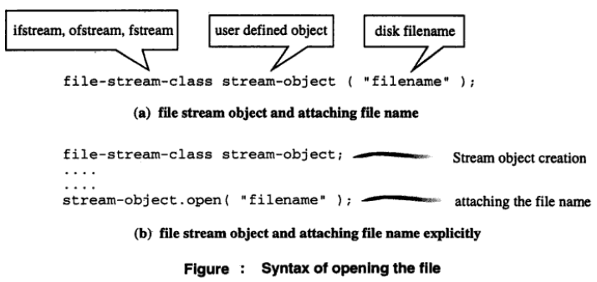
Opening a File

Slide 14
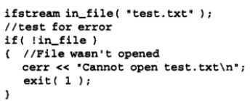
Testing for Errors
The assumption of a file operation (opening, processing, or closing) is always successful in an ideal situation
When a user tries to open an non-existent file in read-mode or tries to open a file in write mode which has been marked as read-only – file operations fail under such circumstances
These errors must be trapped and appropriate actions must be taken before further processing
This can be done using ! operator with an instance of fstream, ifstream, and ofstream. The ! operator is overloaded to return nonzero in case any stream errors have occurred

Slide 15
Testing for Errors
Another Approach to check if the file opened successfully
if (fin.fail()) //! fin
{
cout << "Input file open failed\n";
exit (1);
}
In case of any error the stream will have an error flag which can be checked by fail()
fail() returns true if the last operation failed

Slide 16


Testing for Errors – End of File
Once the file has been opened successfully, a common activity is to read from the file while the end-of-the-file has not yet been reached
Using the name of the file stream instance in place of condition (in if or while) evaluates to non-zero only when no errors have occurred in the file
Hence, errors such as end-of-the-file can be tested as follows
Another approach for detecting end-of-the-file is using the member function eof()

Slide 17
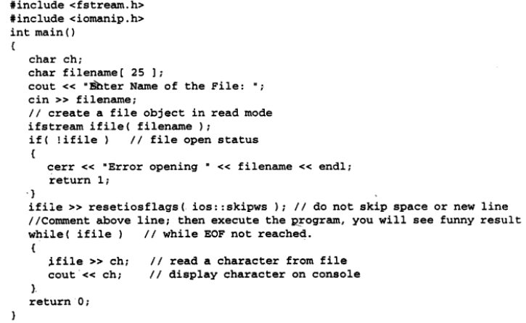
Testing for Errors

Slide 18
File Modes
The ifstream and ofstream constructors and the function open() are used to open the files
Until now a single arguments a single argument is used that is ilename
However,these functions can take two arguments, the second one for specifying the file mode.
The general form of function open() with two arguments is:
stream-object.open(“filename”, mode);
The second argument mode specifies the purpose for which the file
is opened
The default values are as follows
  ios::in for ifstream functions meaning open for reading only
  ios::out for ofstream functions meaning open for writing only

Slide 19
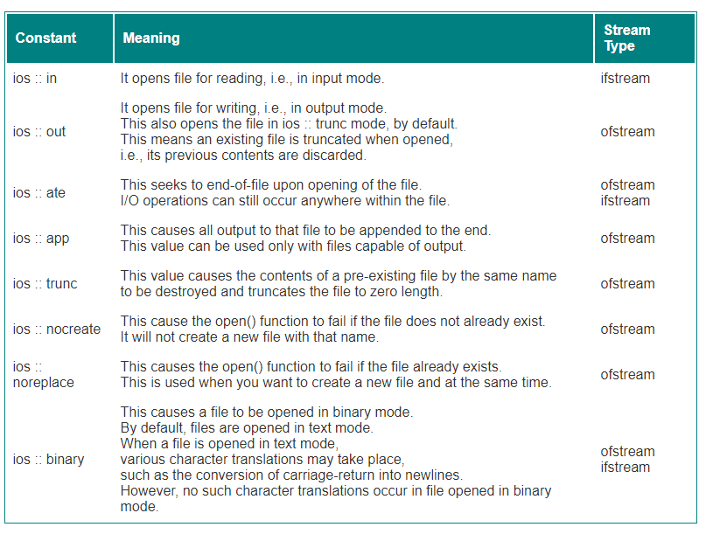
File Modes

Slide 20
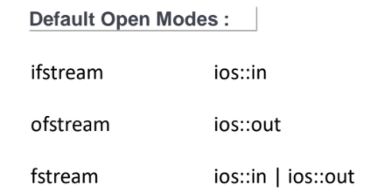
File Modes
We can combine two or more file modes using the operator |
For example
  ofstream fout;
  fout.open("Master", ios :: app | ios :: nocreate);
  fout.open("Master", ios :: app | ios :: binary);
  fout.open("Main", ios :: out | ios :: nocreate | ios :: binary);

Slide 21
File Pointers
Each file has two associated pointers known as the file pointers
One of them is called the input pointer or get pointer
  The get pointer specifies a location from which the current reading operation is initiated
  The put pointer specifies a location from where the current writing operation is initiated
We can use these pointers to move through the files while reading or writing
The input pointer is used for reading the contents of a given file location and the output pointer is used for writing to a given file location
Functions for manipulation of file pointers
seekg() Moves get pointer (input) to a specified location
seekp() Moves put pointer (output) to a specified location
tellg() Gives the current position of the get pointer
tellp() Gives the current position of the put pointer

Slide 22
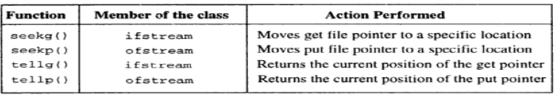
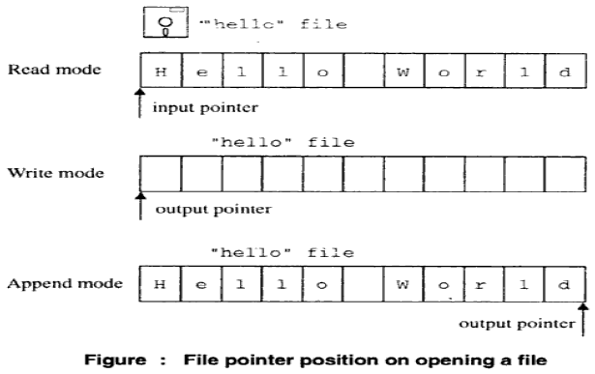
File Pointers

Slide 23
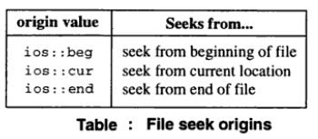
File Pointers
The two seek functions have the following prototypes
Both functions set a file pointer to a certain offset relative to the specified origin.
The second parameter origin represents the reference point from where the offset is measured

Slide 24
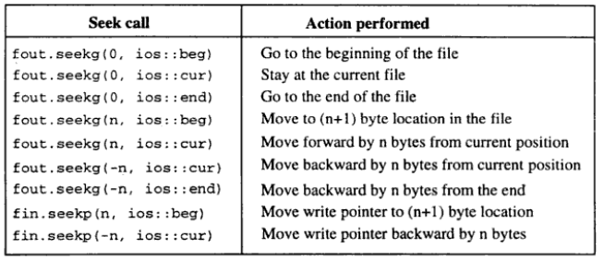
Seek calls and their actions

Slide 25
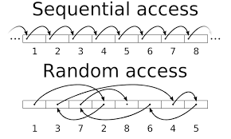
Sequential vs Random Access Files
A sequential file has to be accessed sequentially – ie., to access the particular data in the file, all preceding data items have to be read and discarded
A random access file allows access to the specific data without the need for accessing its preceding data items

Slide 26
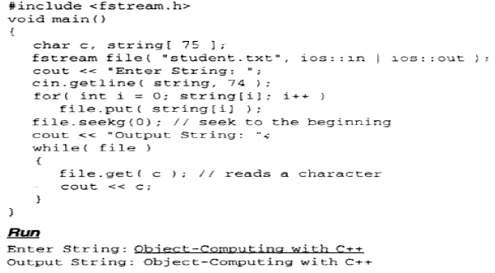
Put( ) and get( ) Functions
The C++ file stream system supports a wide variety of functions to perform I/O operations on files
The functions put() and get() are (member functions of fstream class) designed to manage single character at a time
The functions write() and read() are designed to manipulate blocks of character data

Slide 27
getline() function
getline function - used to read a string that includes whitespace characters and the get/put function can be used to read and write a single character
Syntax
The function stops reading characters when the delimiter character or end-of-file mark is encountered
If the delimiter is encountered, it is read but not stored in the array.
The third argument delimitChar has a default value ('\n'). The getline function is defined in the iostream header file
Suppose a file named state.txt is created that contains the state names delimited by the pound (#) symbol

Slide 28

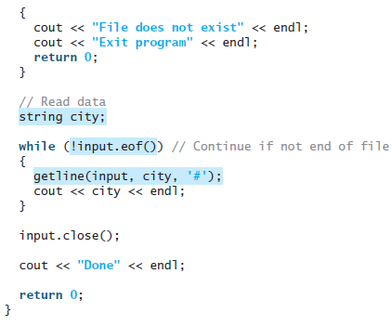
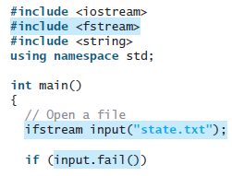

getline() function
The following diagram shows the contents in the file

Slide 29
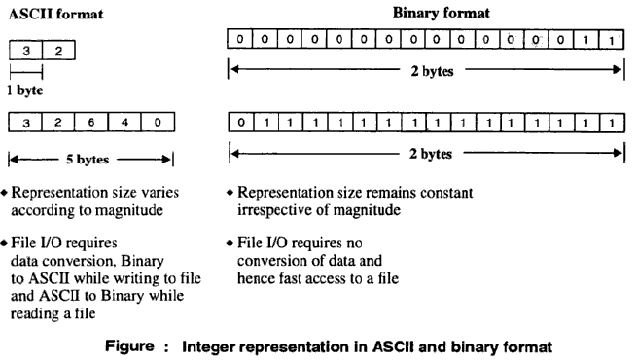
ASCII and Binary Files

Slide 30
write( ) and read( ) Functions
To store and retrieve data in binary form, the functions read() or write() can be used
functions read() and write() access the data in binary format
Syntax
The first parameter is a pointer to a memory location at which the data retrieved from the file is to be stored in cased of read() and address at which the data is to be written when retrieved from the file in the case od write()
The second parameter indicates the number of bytes to be transferred

Slide 31
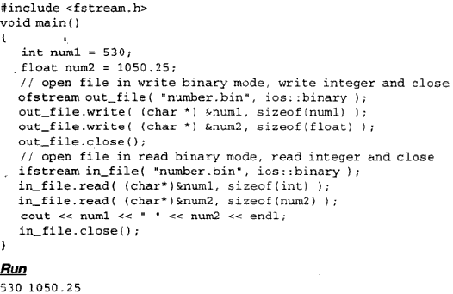
write( ) and read( ) Functions- Example

Slide 32
Object I/O
#include <iostream>
#include <fstream>
using namespace std;
class student
{
private:
char name[30];
int age;
public:
void getData(void)
{ cout<<"Enter name:";
cin.getline(name,30);
cout<<"Enter age:";
cin>>age;
}
void showData(void)
{ cout<<"Name:"<<name<<",Age:“
<<age<<endl;
}
};
int main()
{
student s;
ofstream file;
file.open("aaa.txt",ios::out);
s.getData(); //read from user
file.write((char*)&s,sizeof(s)); //write into file
file.close(); //close the file
ifstream file1;
file1.open("aaa.txt",ios::in);
file1.read((char*)&s, sizeof(s));
s.showData();
//close the file
file1.close();
}

Slide 33
Object I/O – Array of Objects
void Student::getdata(){
char ch;
cin.get(ch);
cout<<"Enter name : ";
cin.getline(name,40);
cout<<"Enter grade : ";
cin>>grade;
cout<<"Enter marks : ";
cin>>marks;
cout<<"\n";
}
void Student::display(){
cout<<"Name : "<<name<<"\t";
cout<<"Grade : "<<grade<<"\t";
cout<<"Marks : "<<marks<<"\t"<<"\n";
}
#include <iostream>
#include <fstream>
#include <stdlib.h>
using namespace std;
class Student{
private:
char name[40];
char grade;
float marks;
public:
void getdata();
void display();
};

Slide 34
Object I/O – Array of Objects
int main() {
int n;
Student s1;
fstream f;
f.open("stu.txt",ios::in|ios::out|ios::binary);
if(!f){ cerr<<"Cannot open file !";
return 1; }
cout<<“enter the number of students”;
cin>>n;
for(int i=0;i<n;i++){
s1.getdata();
f.write((char*)&s1, sizeof(s1));
}
f.seekg(0);
cout<<"The contents of stu.txt are shown below : \n";
for(int j=0;j<n;j++){
f.read((char*)&s1,sizeof(s1));
s1.display();
}
f.close();
}

Slide 35
Error Handling
There are many problems encountered while dealing with files
A file which we are attempting to open for reading does not exist
The file name used for a new file may already exist
We may attempt an invalid operation such as reading past the end-of-file
There may not be any space in the disk for storing more data
We may use an invalid file name
We may attempt to perform an operation when the file is not opened for that purpose
Stream object created but not connected to a file

Slide 36
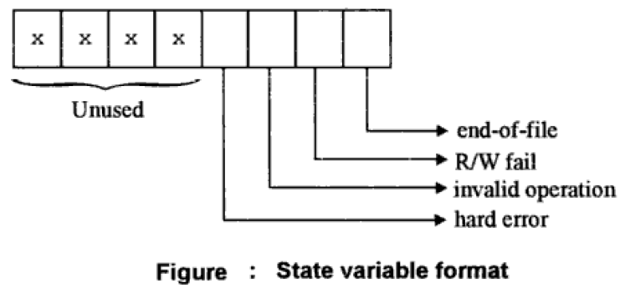
Error Handling
Every stream (ifstream, ofstream, and fstream) has a state associated with it
Errors and non-standard conditions are handled by setting and testing this state appropriately
The stream status variable and information recorded by its bits is shown below
The ios class supports several functions to access status record in the data member io_state

Slide 37
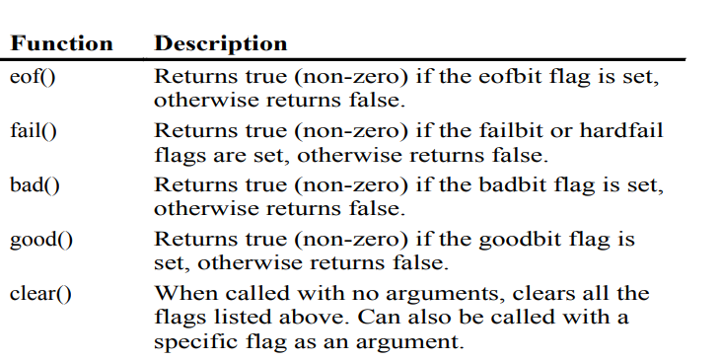
Error Handling

Slide 38
Error Handling
if (infile.eof())
{
……………(terminate the program normally)
}
else
if (infile.bad())
{
…………….(report fatal error)
}
else
{
infile.clear(); //clear error state
……….
……….
}
……..
………..
The function clear() resets the error state so that further operations can be attempted.
ifstream infile;
infile.open(“ABC”);
while(!infile.fail())
{
…………
}

